Slide 1

this here
on up
good jump
big saw
help she
have find
run say
all did
went what
down you
for with
can he
pretty that
do want
we at
the my
look and
it me
in to
see go
come like
is am
little not
play will
funny ride
where said
are but
so who
get please

Slide 2
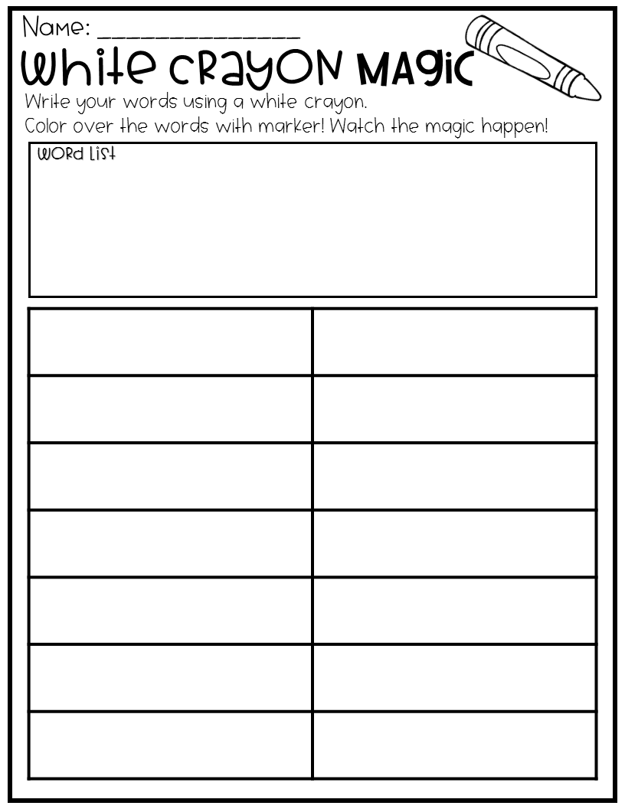

Slide 3
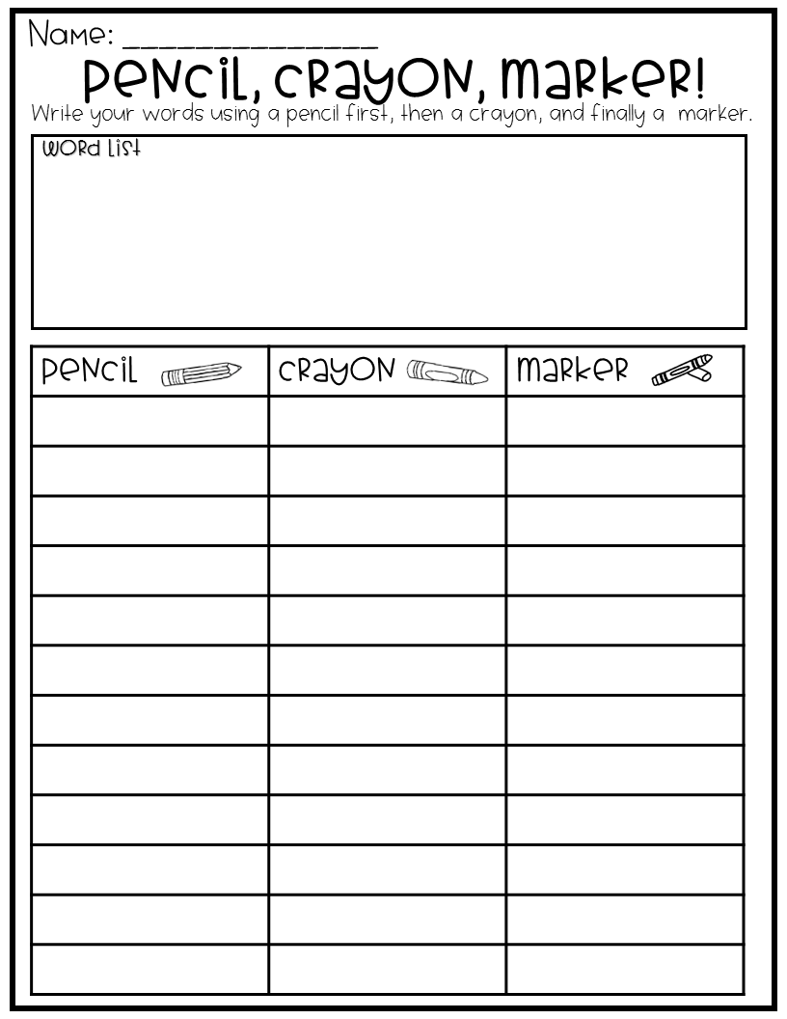

Slide 4
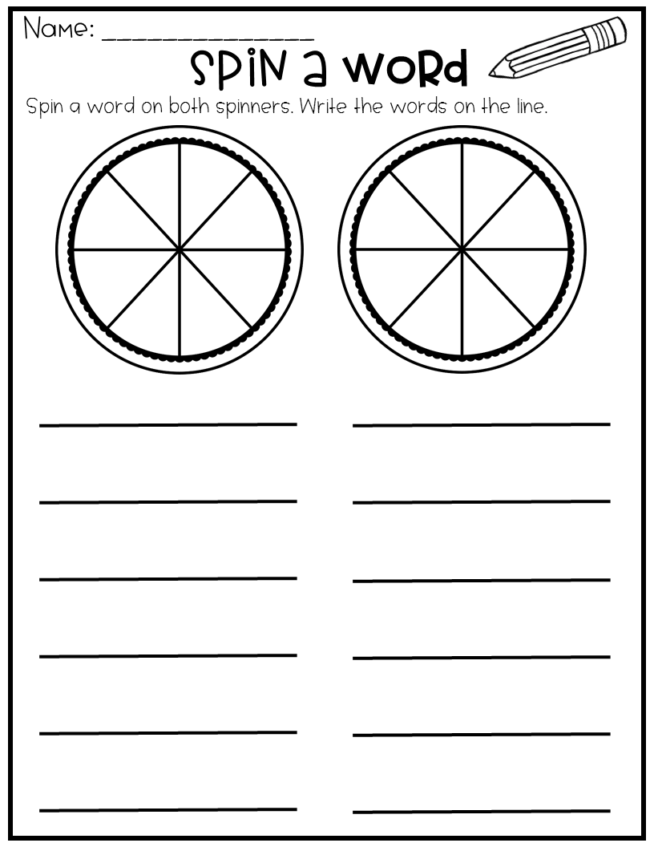

Slide 5
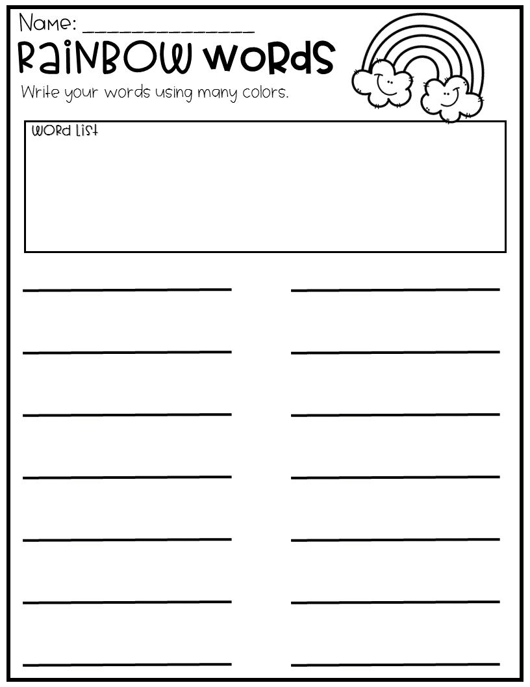

Slide 6
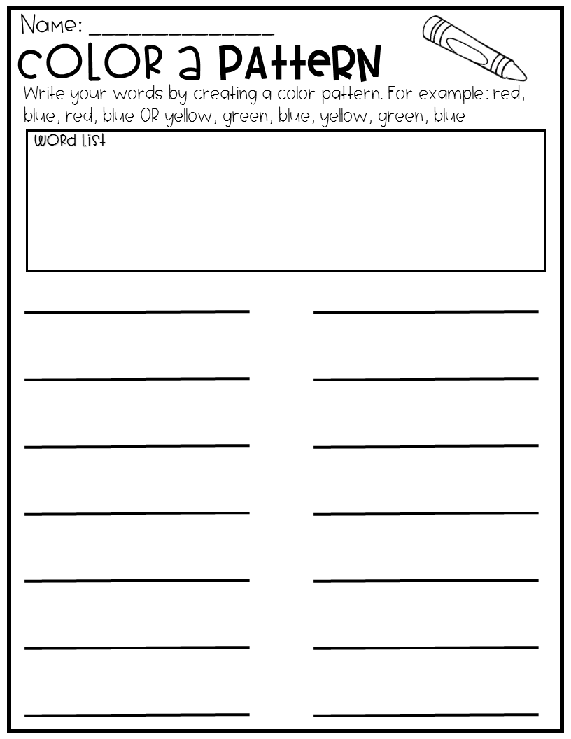

Slide 7
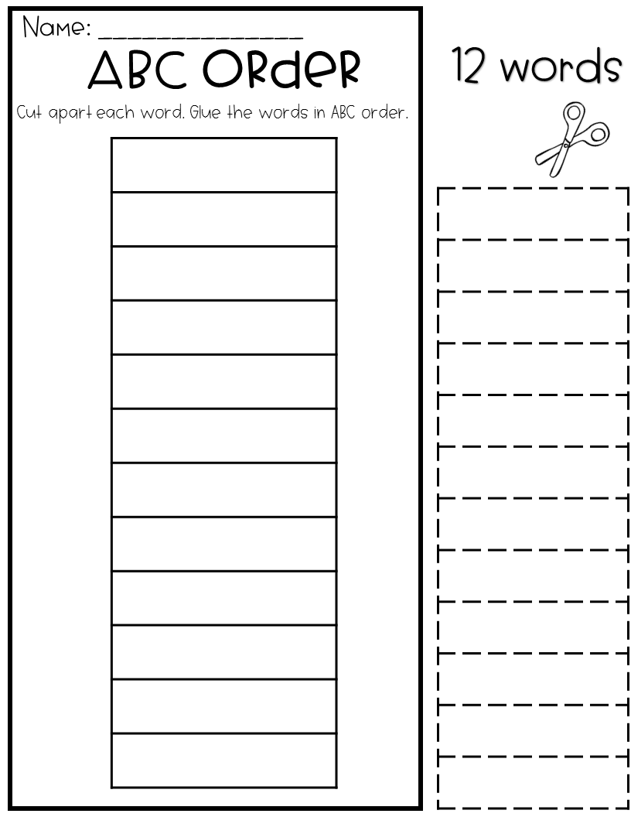

Slide 8
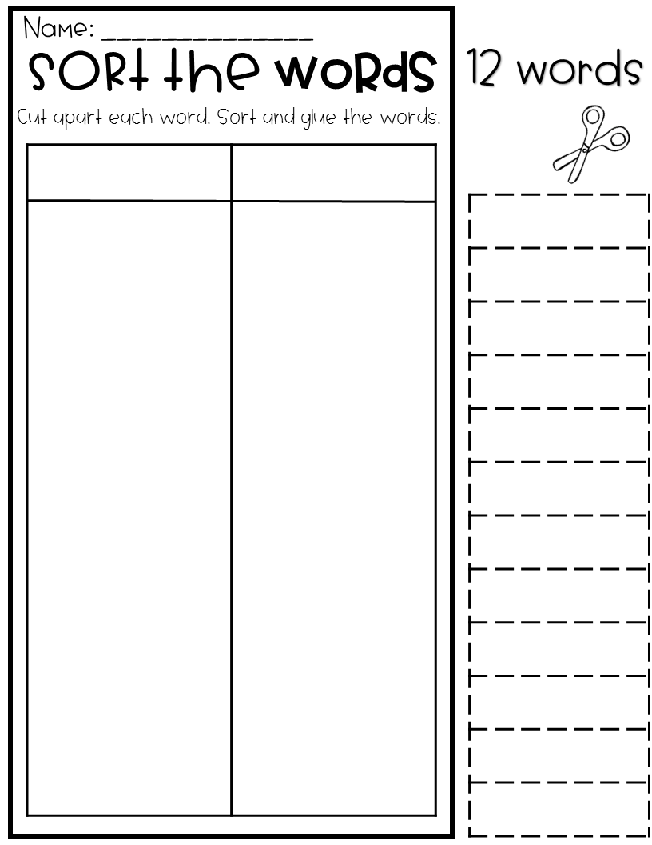

Slide 9


Slide 10
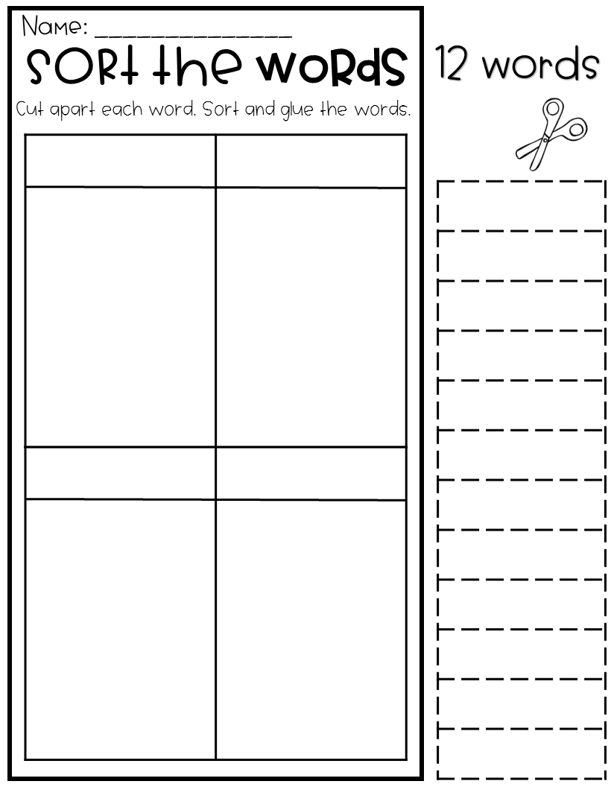

Slide 11
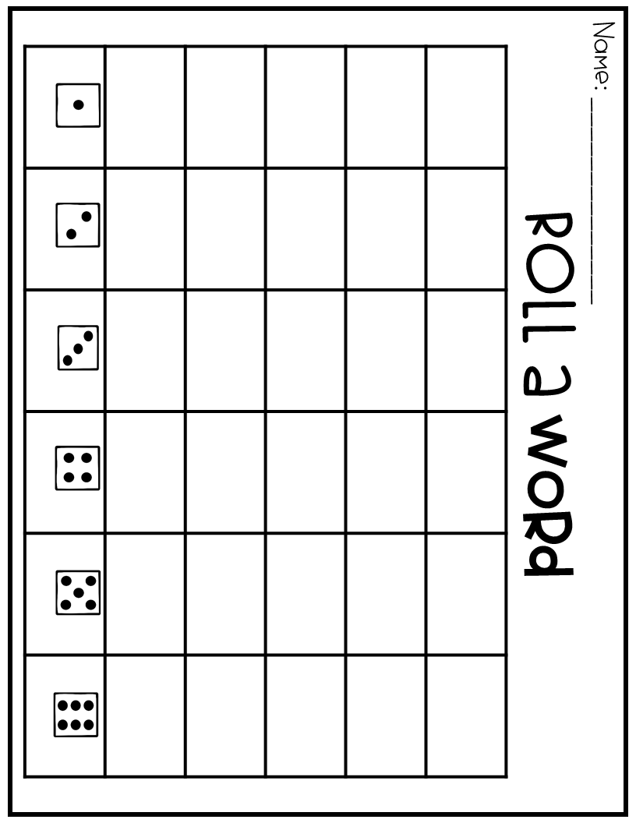

Slide 12
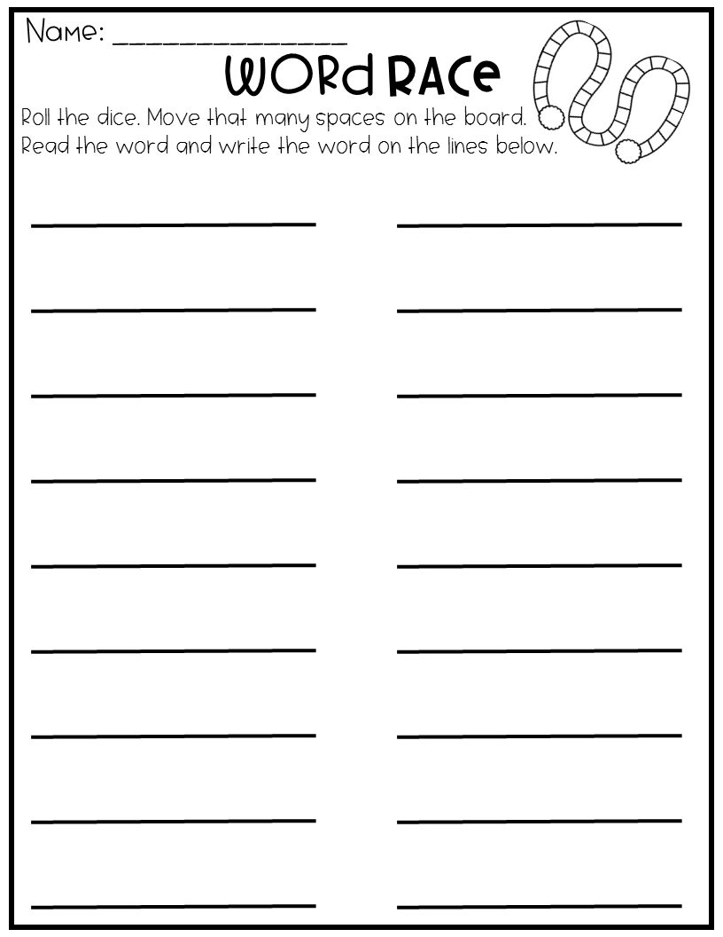

Slide 13
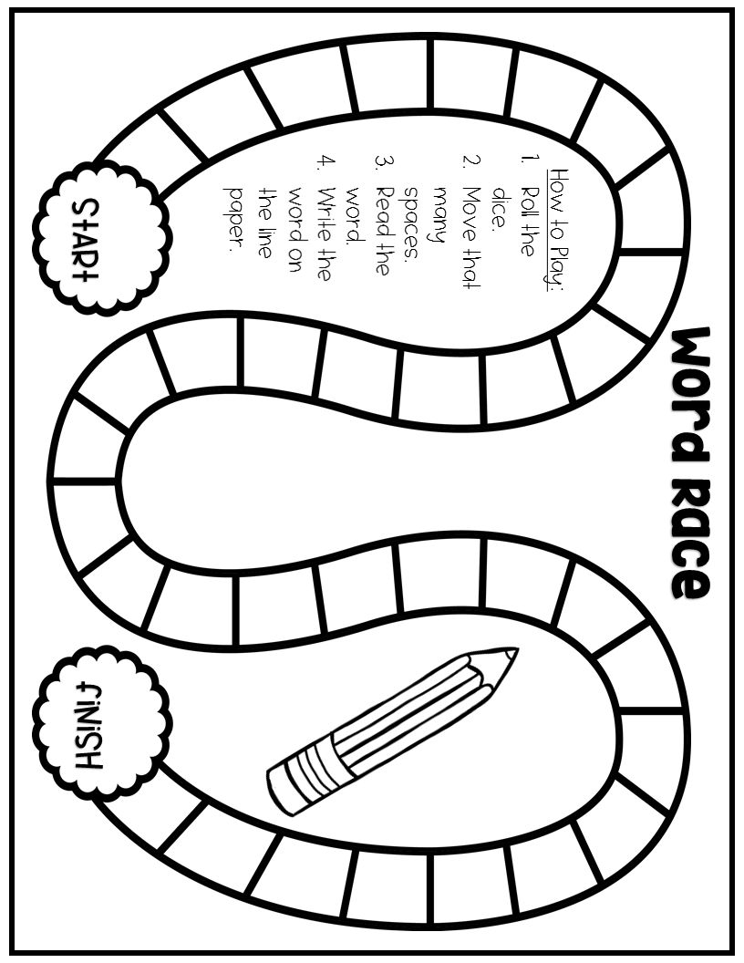

Slide 14
